Slide 1
Machine Learning Approach for Heart Disease Prediction
PRESENTED BY
NAEEB MD RIDWAN
FUAD TANVIR OMI

Slide 2
Objectives
Academic Objectives
Learning the usage of data set
Getting introduced with Python
Long Term Goal
A software solution for Prognosis
Heart disease symptom analysis
Dig deep into Machine Learning

Slide 3
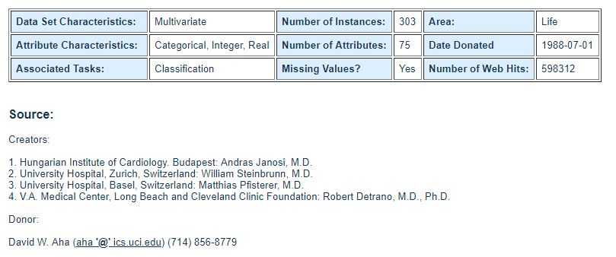
Dataset

Slide 4
Dataset (continues)
Contains 14 active attributes
Determine the presence of heart disease in the patient
Integer valued from 0 to 4 to denote the presence of heart disease
0 means no presence
4 means severe condition

Slide 5
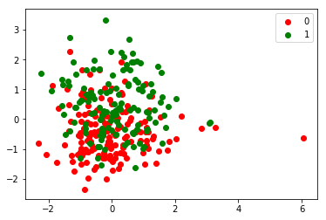
Algorithm
SVM
Linear SVC
RBF

Slide 6
Conclusion
Our Thesis Topic: Healthcare application with machine learning
Key Features
Prognosis of different diseases
Self learning system to provide health service
Appointment system

Slide 7
References
V. Chaurasia and S. Pal, "Early Prediction of Heart Diseases Using Data Mining Techniques", Carib. J. SciTech, vol. 1, pp. 208-2017, 2013.
A. Hazra, S. K. Mandal, Gupta, Mukherjee, A.Gupta, A. Mukherjee and A. Mukherjee, “Heart Disease Diagnosis and Prediction Using Machine Learning and Data Mining Techniques”, Jvol.10, pp.2137-2159, 2017.
P. V. Ankur Makwana, “Identify the patients at high risk of re-admissionin hospital in the next year,” International Journal of Science andResearch, vol. 4, pp. 2431–2434, 2015
D. Tomar and S. Agarwal, "A survey on Data Mining approaches for Healthcare", Int. J. Bio-Sci. Bio-Technol., vol. 5, no. 5, pp. 241-266, 2013.
M. Cottle, W. Hoover, S. Kanwal, M. Kohn, T. Strome, N. and W. Treis-ter. "Transforming Health Care Through Big Data" in, Washington DC, USA:Institute for Health Technology Transformation, 2013.

